Slide 1
A Power Platform Independent Connector for IBM Watson Cognitive Services (Hypothetically used by the NHS)
Group 16

Slide 2
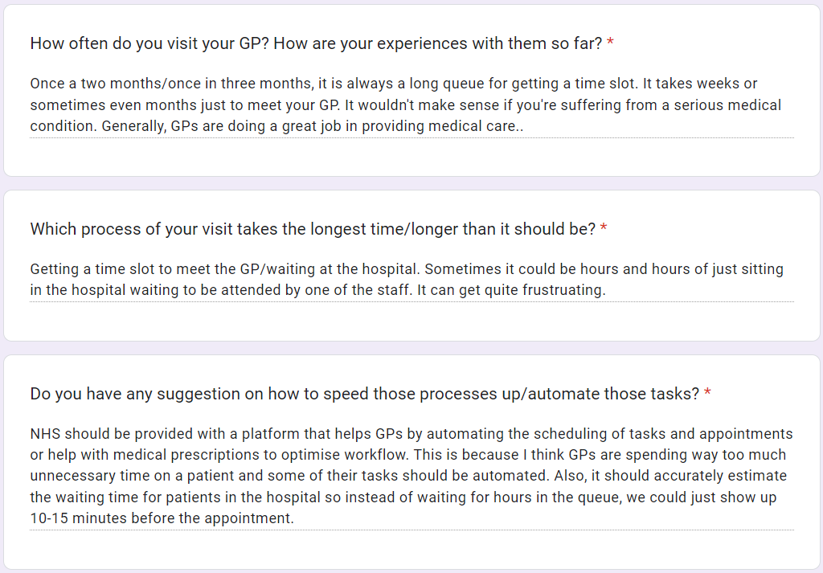
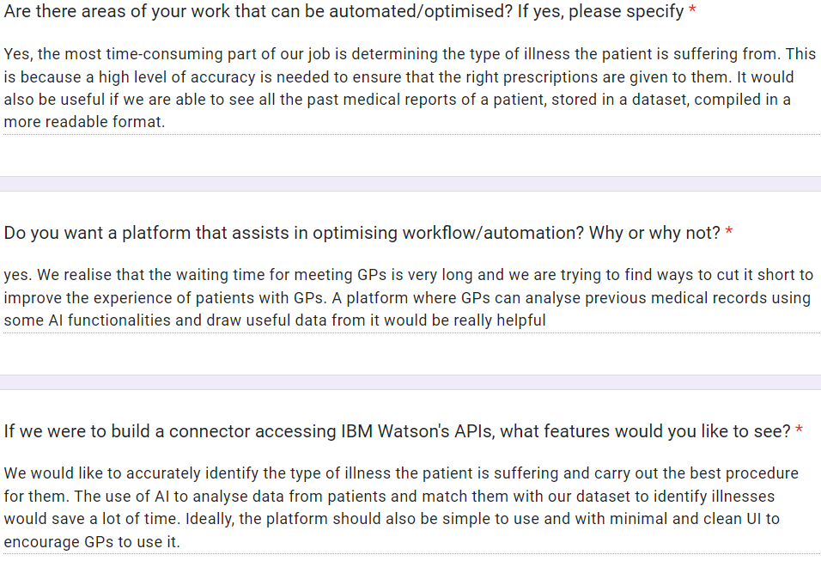
Gathering User Requirements
After discussing methods of gathering user requirements, we decided to send out Google Forms to General Practitioners (GPs) and Patients to fill them up. Here are some responses :
From patients
From GPs

Slide 3

Personas
With the responses from google forms, we constructed personas for both our stakeholders to design a platform that meets their needs.
John Smith, 50, Male, A general practitioner of 20+ years in a local hospital.
Needs
Identify patients' illness accurately based on their symptoms
Carry out appropriate treatment to specific illness
Identify potential health threats for a patient
Dislikes
Large unsorted data set displayed in plain text
Complicated UI
Steep learning curve for new tech
Ideal Features
A good visualizing database with patients' personal information and past medical records
An AI tool that predicts possible illnesses that a patient is suffering from (by matching similar symptoms/medical issues)

Slide 4

Personas
Steven Barnes, 70, Male, A patient with frequent joint pain and muscle soreness.
Needs
Reliable GP that can treat most acute and chronic illnesses
Dislikes
Long queues to reserve a time slot for consulting GPs
GPs giving the wrong advice due to lack of information
Ideal Features
A smart scheduling system that cuts wait time by fitting more appointments in a time slot.
An integrated platform to fill in their information and medical records that is accessible by all GPs

Slide 5
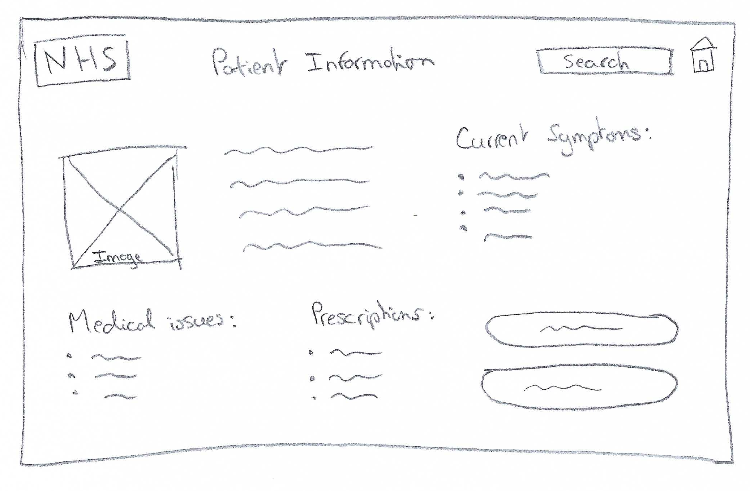
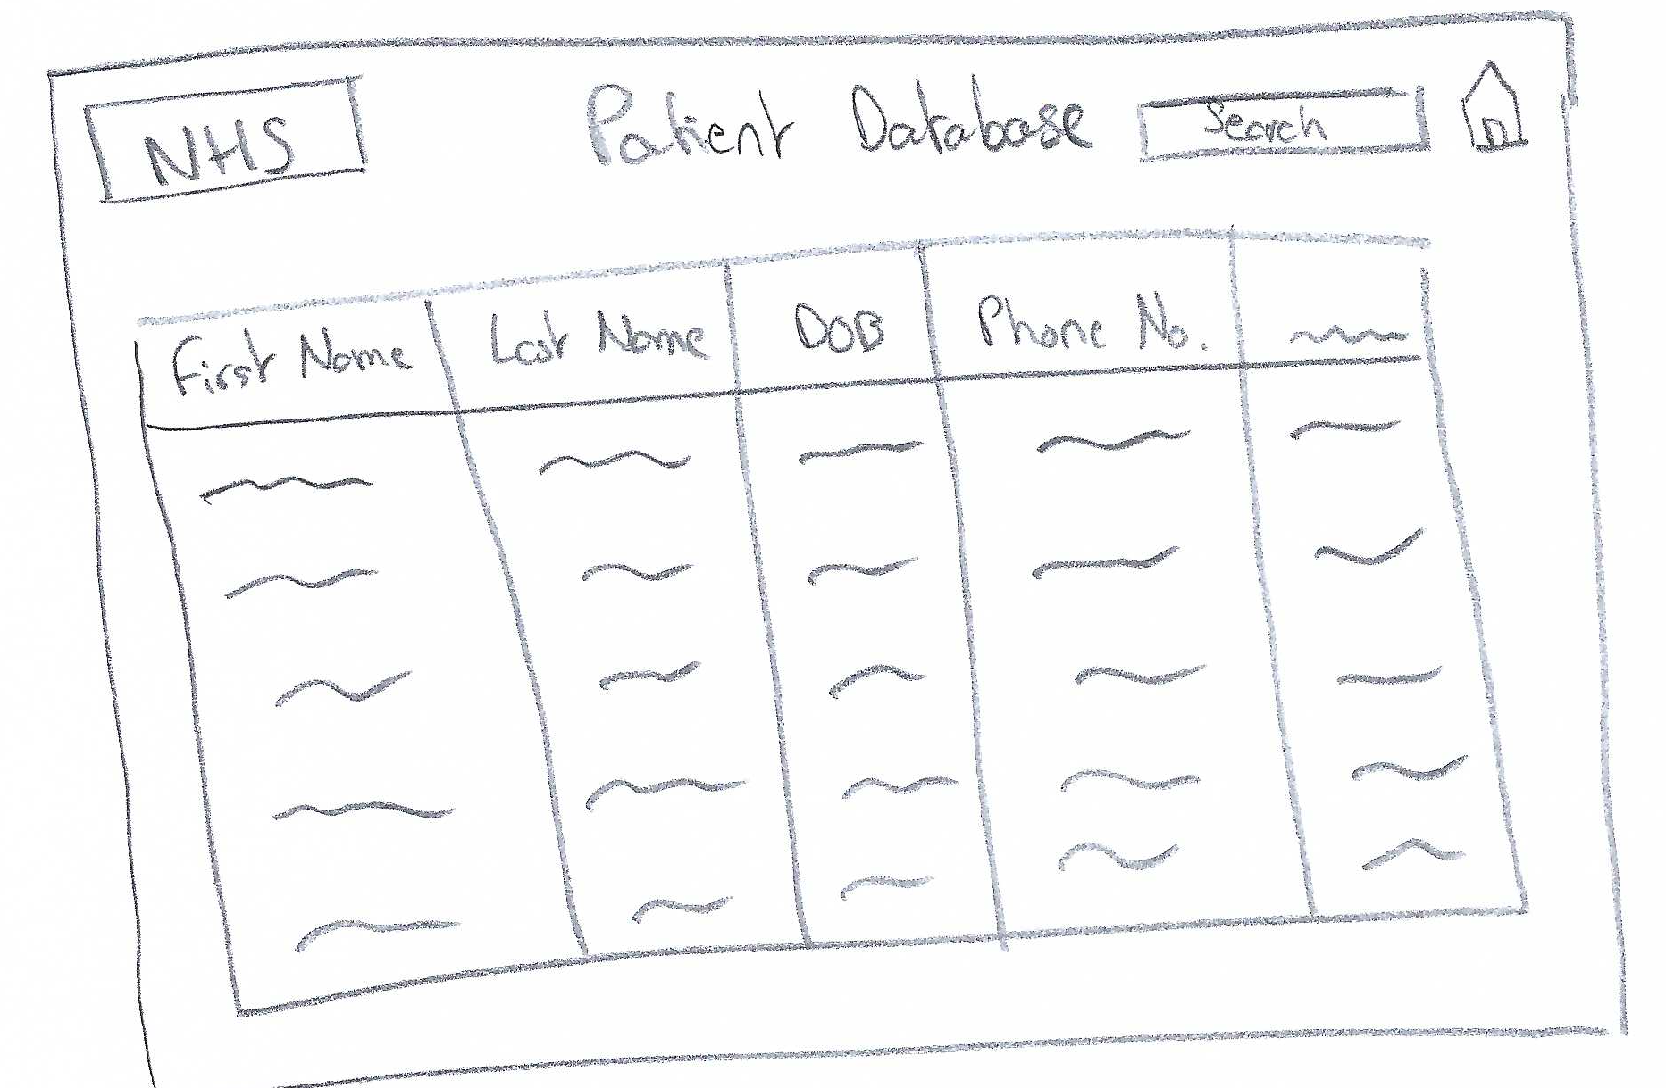
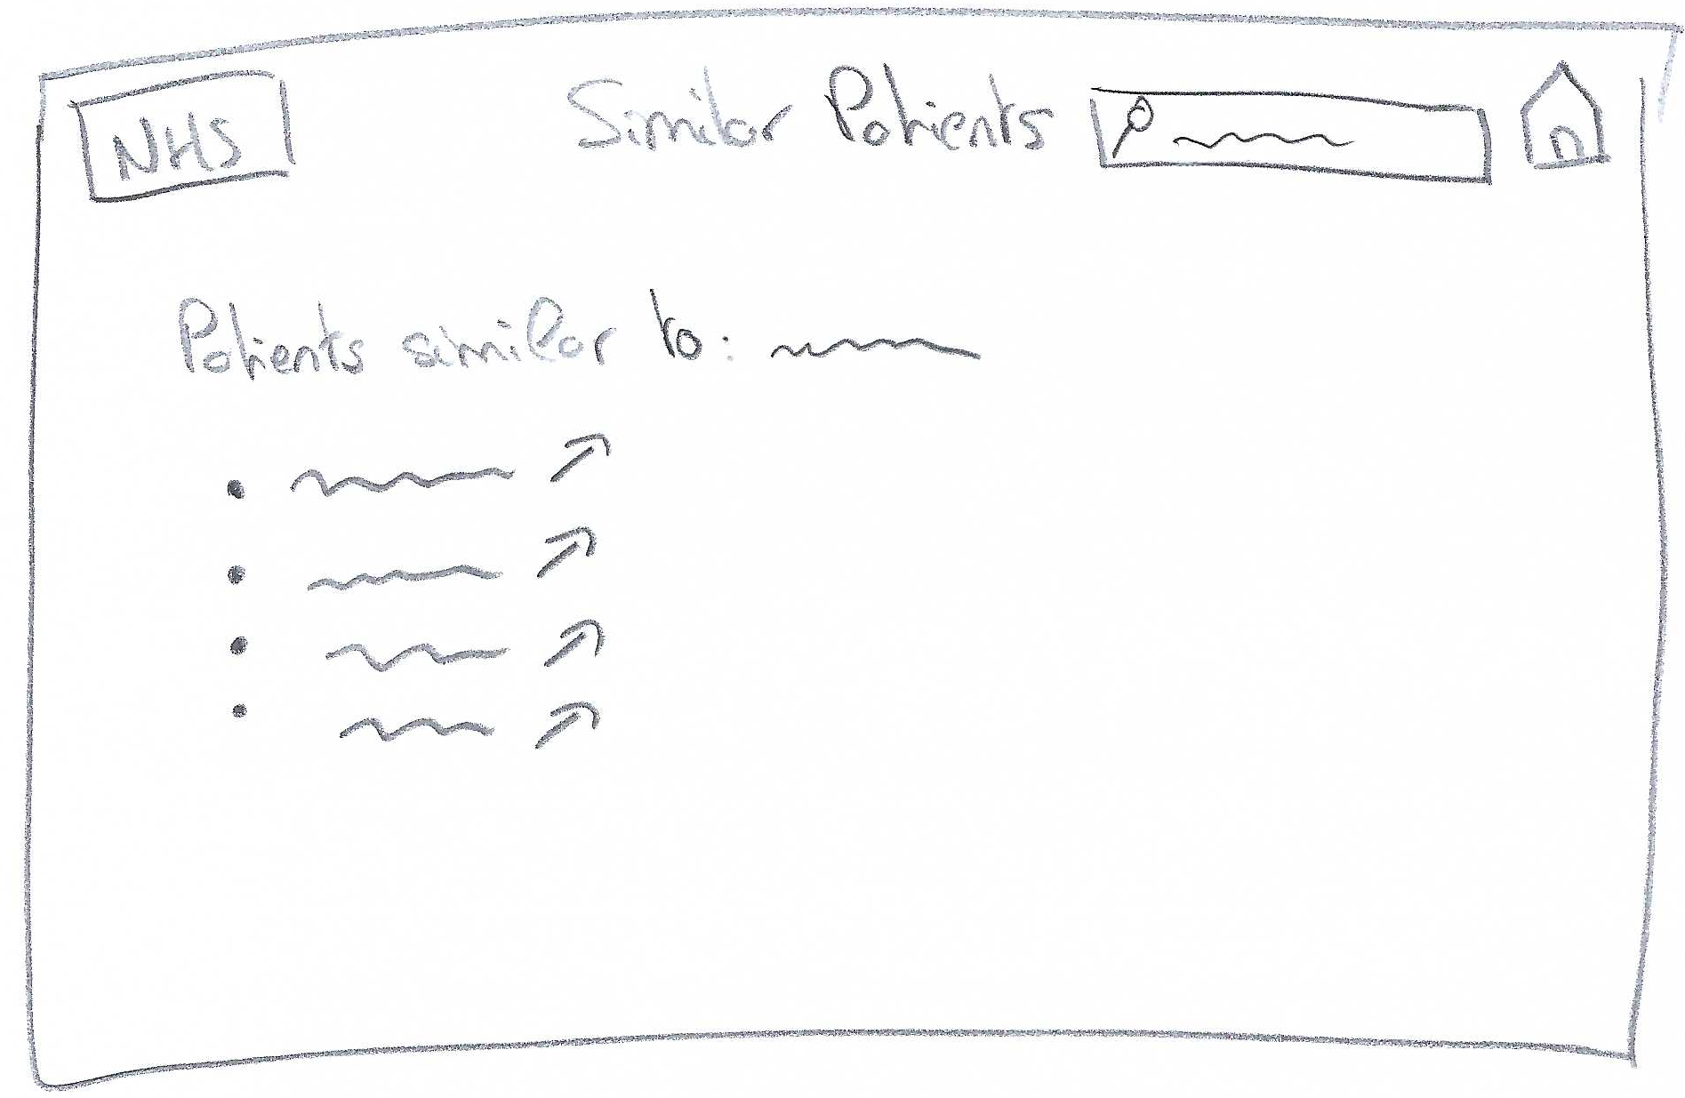
Sketches
Once we had collected enough user requirements and explored personas to better understand our design goals, we produced some sketches of our NHS web application.

Slide 6
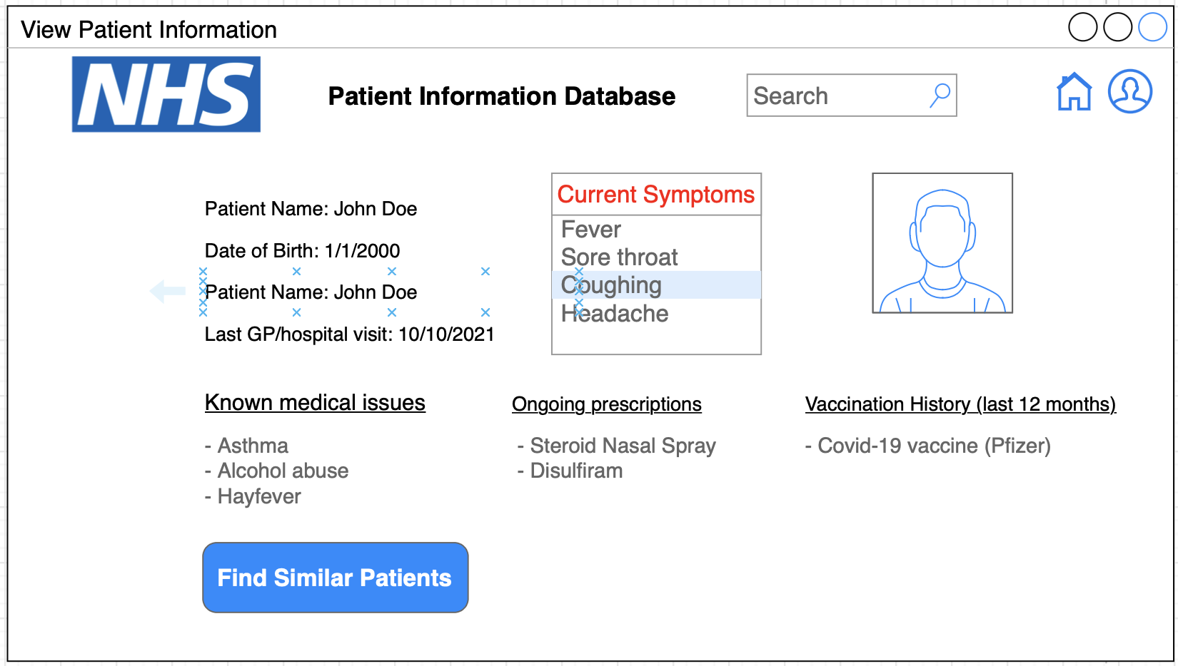
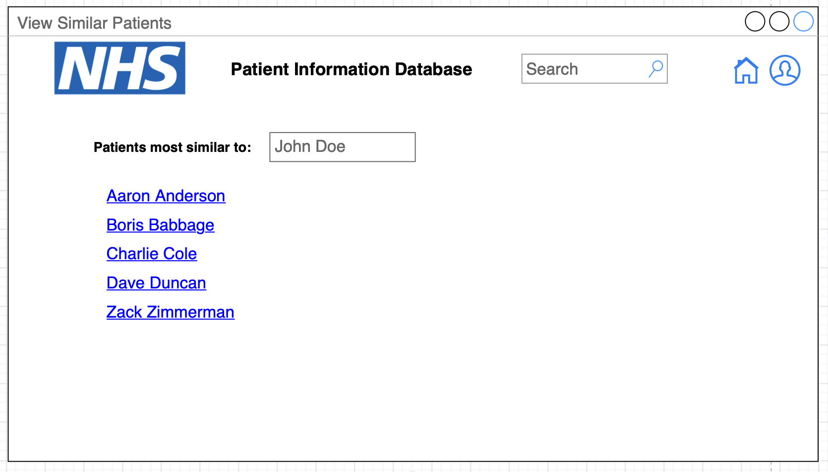

First Prototype
Home
John Doe
First Name | Last Name | DOB | Phone No. | Last Visited
John | Doe | 21/01/1955 | 07953707369 | 10/10/2021
Muhammad | Salah | 01/05/1978 | 07375937592 | 01/11/2022
Lisa | Grace | 17/05/1990 | 07375816321 | 09/10/2022
James | Milner | 06/03/1967 | 07738275923 | 03/11/2021
Abdul | Fata | 08/07/1956 | 07883826132 | 26/12/2021
Mary | Higgins | 23/12/1949 | 07934583434 | 04/06/2022
Jack | Harrison | 29/02/1980 | 07949482312 | 19/05/2022

Slide 7
Evaluation and feedback
User Test: The GP suggested the use of AI to identify possible types of illnesses based on the patient's symptoms
Heuristics evaluation
Heuristic | What can be improved | Score
User control and freedom | Add a button to return to the patient information screen from the 'similar patients' screen | 3
Aesthetic and minimalist design | Increase the line spacing and move blocks further apart from one another on the patient information page Display vaccination information when button is clicked, as most patients won't have received vaccinations recently | 1

Slide 8
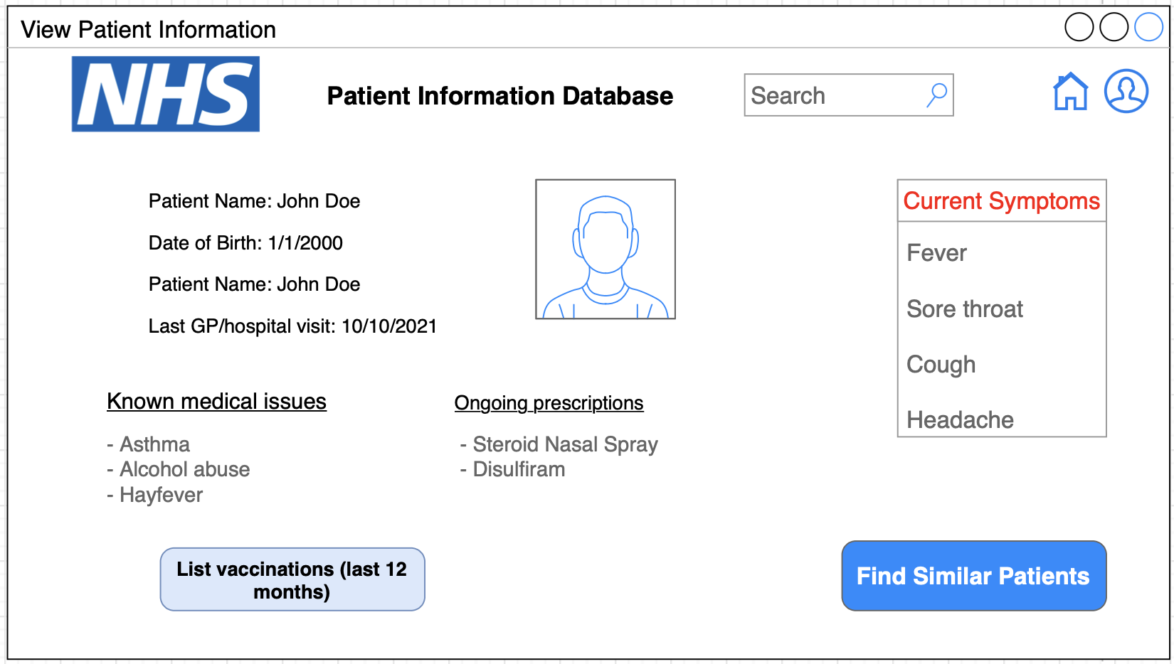
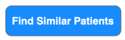
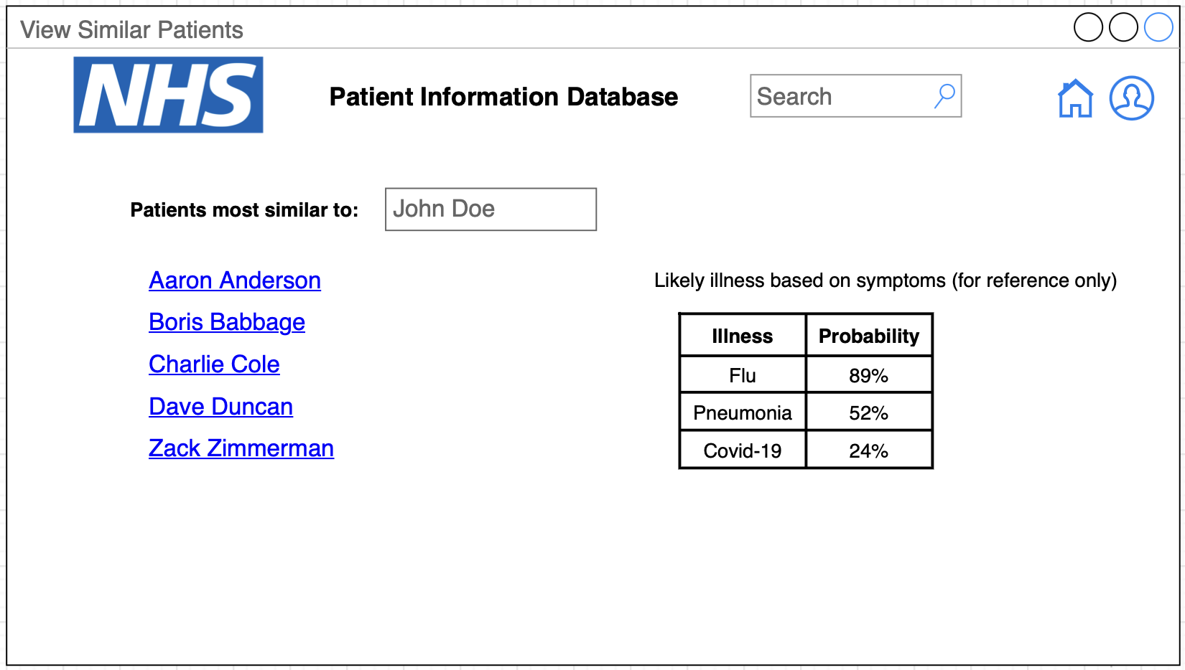
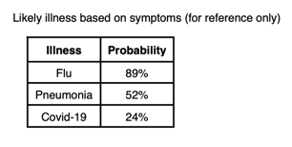

Improved Prototype
Further down the development path, additional features such as illness prediction generated by AI could be implemented as shown in the pictures. This can be done by matching the patients’ medical issues/symptoms with possible illnesses.
Possible Illness
Find Similar Patients

Slide 9
References
DragonImages. Portrait of unsmiling mature general practitioner in glasses. Available at: https://th.bing.com/th/id/R.2e2e2c55a9074ada54c11e45e848b76a?rik=rslBi9RY1g0n1Q&pid=ImgRaw&r=0 (Accessed: 7 November 2022)
Nyul. Portrait of smiling old man having coffee, looking happy. Available at: https://thumbs.dreamstime.com/b/smiling-old-man-having-coffee-portrait-looking-happy-33471677.jpg (Accessed: 7 November 2022)

